Slide 1
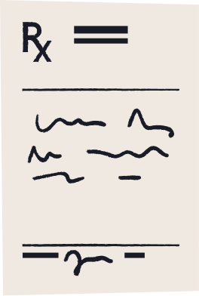

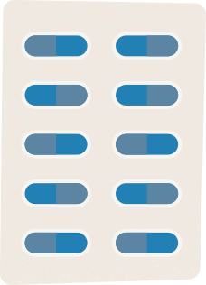
Brain Tumor Image Segmentation
Group 4 Final Presentation
Alana Burrell , Johndell Cumberbatch
SMAT 470- Intro to Deep Learning
Dr. Erdi Kara
Notes:
Topics you must touch on (7x):
Dice loss
Jaccard loss
intersection over accuracy(IOU)
augmentation methods for image segmentation
semantic segmentation
u-net
https://docs.google.com/presentation/d/1E8BDdEbMqqabGqpFkye7WOkMBlT5IyDos2VF07Cq_wQ/edit#slide=id.g22a0bbd5f64_0_8

Slide 2
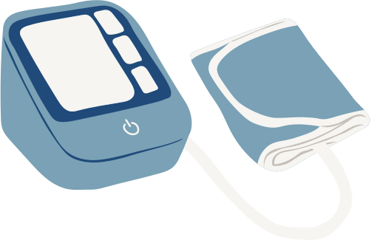

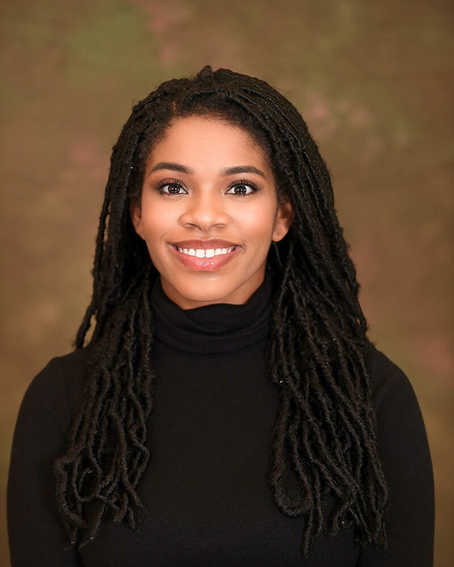


Meet the Team
Group 4
SPELMAN COLLEGE
Alana Burrell
Johndell Cumberbatch
Senior
Comp. Science & Comp. Engr.
Senior
Economics
Notes:
https://colab.research.google.com/drive/1aF5mHbr6s0_0yT6-fRGpomfrlV1wNTbW

Slide 3


Presentation Outline
01
Abstract
02
Introduction & Background
03
Image Segmentation Techniques and Models
04
Performance Evaluation
05
Data Augmentation
06
Loss Functions for Image Segmentation
07
Results
08
Conclusion
Notes:
Image Segmentation Techniques and Models
Performance Evaluation
Data Augmentation
Loss Functions for Image Segmentation
Results
Conclusion

Slide 4
Abstract
This presentation explores the efficiency in using image segmentation techniques to identify LGG tumors in brain images.
We discuss the U-Net architecture, a popular deep learning model for image segmentation, as well as different loss functions such as Dice and Jaccard coefficients that can improve the accuracy of the segmentation model.
Next, we cover data augmentation techniques and how they can increase the diversity of the training dataset and improve the model's performance.
Finally, we evaluate the performance of the segmentation model using metrics such as IOU, Dice, and Jaccard coefficients and present a conclusion highlighting the potential impact of this project on the field of medical image analysis.
Notes:
Our project attempts to answer the hypothesis of whether or not using image segmentation techniques can improve the efficiency in identifying the LGG brain tumor through images.
We cover using the u-net architecture and different loss functions to improve the accuracy and performance of our model.
And lastly, we review how this type of technique can impact the field of medical image analysis.

Slide 5


Introduction & Background
Notes:
I. Introduction & Background
Introduce the project and its purpose...
Briefly discuss LGG tumors and the importance of early detection
Explain image segmentation and its importance in medical imaging
Describe different types of image segmentation techniques
Discuss the challenges of image segmentation in medical imaging

Slide 6

Introduction & Background
Cancerous Brain Tumor
Variety of Symptoms
Low-grade gliomas are cancerous brain tumors that arise from the support cells (glial cells) within the brain.
LGG tumors can cause a variety of neurological symptoms that are not distinct and may overlap with other conditions, such as seizures, headaches, and vision problems.
Common in Young Adults
Difficult Diagnosis
These slow growing tumors are most common in in young adults aged 24-35 years old.
LGG tumors can be difficult to detect in their early stages, which delays the diagnosis. Additionally, LGG tumors can vary in size, location, and symptoms, which further complicates the diagnosis.
Notes:
LGGS, or low grade gliomas, are slow growing, cancerours brain tumors that typically present themselves through a variety of symptoms and is most common in young adults. The treatment for these tumors is crucial and so is an early and accurate diagnosis!
identifying the specific areas in the brain that are affected by LGGs can be challenging for doctors because LGGs can grow slowly and infiltrate the surrounding brain tissue, making it difficult to distinguish between healthy and affected tissue on imaging tests such as MRI.
When doctors use methods to better identify this tumor they can more accurately identify and locate LGGs, which can improve treatment outcomes and quality of life for patients.

Slide 7
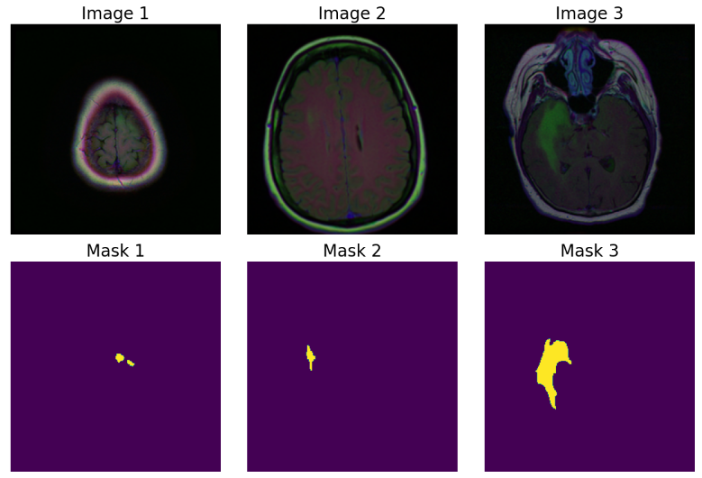
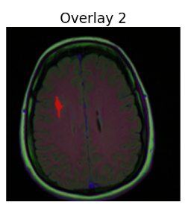

Introduction & Background
Original Image
Predicted Image
Mask
Notes:
The aim of this project was to be able to use image segmentation to predict the area of the brain where an LGG tumor may be from an MRI scan.
First, The model will take an MRI and then it will produce a prediction of where it believes the brain tumor is located, which will then be compared with that image's mask which only presents the singled out tumor.
The accuracy of the model is determined by how well the predicted image compares to the mask.

Slide 8






Image Segmentation
Techniques and Models
Notes:
III. Image Segmentation Techniques and Models
Define semantic segmentation and how it differs from other types of image segmentation...
Discuss the advantages and disadvantages of using U-Net for medical image segmentation
Provide examples of how U-Net has been used for identifying LGG tumors
IMAGES:
Include examples of LGG tumors and images that demonstrate different types of image segmentation techniques such as
semantic segmentation, instance segmentation, and binary segmentation.
You could also include images that demonstrate how U-Net architecture works for image segmentation.

Slide 9
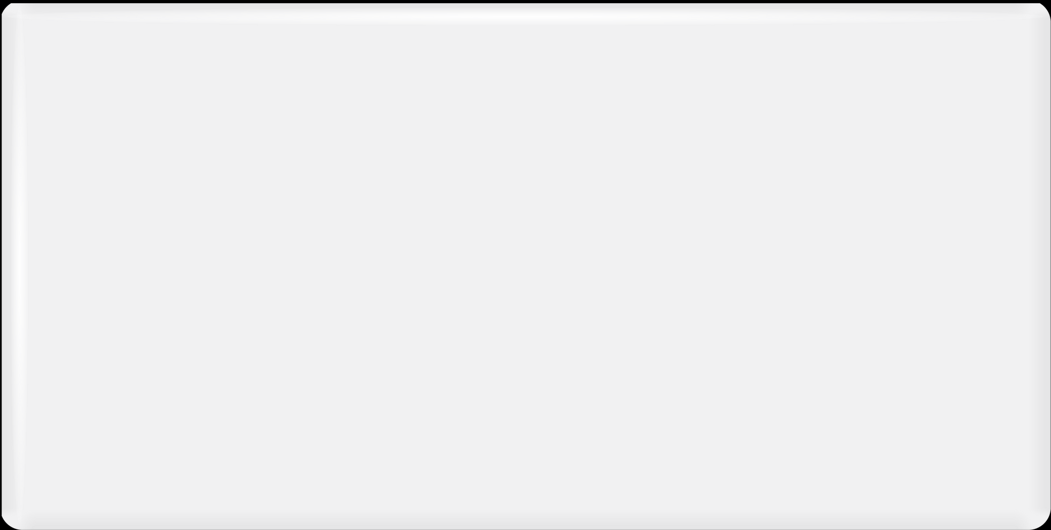
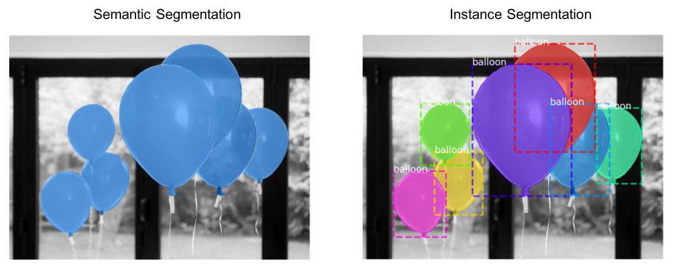
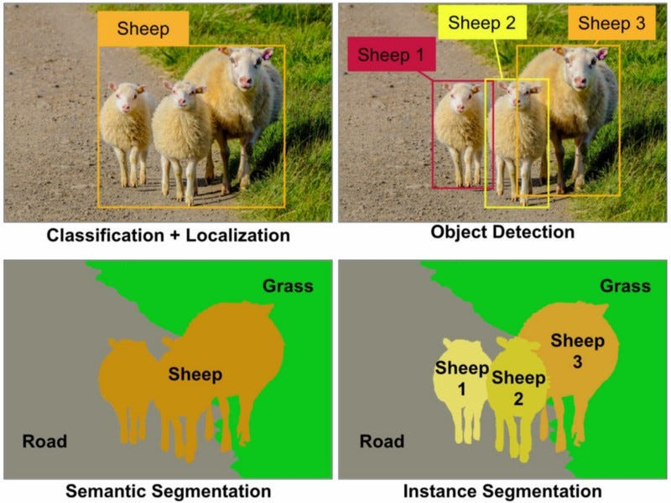
Image Segmentation
Techniques and Models
Notes:
The main difference between semantic segmentation and other types of image segmentation is that semantic segmentation assigns a semantic label to each pixel in the image, while other types of segmentation focus on identifying specific objects or boundaries within the image.
https://neurohive.io/wp-content/uploads/2018/11/expert-vs-unet.jpeg
https://www.google.com/url?sa=i&url=https%3A%2F%2Fwww.mdpi.com%2F2073-431X%2F10%2F11%2F139&psig=AOvVaw0XExsTQgHF4Dn3EpJL0ryq&ust=1683577559745000&source=images&cd=vfe&ved=0CBAQjRxqFwoTCPDEnKWF5P4CFQAAAAAdAAAAABAE

Slide 10
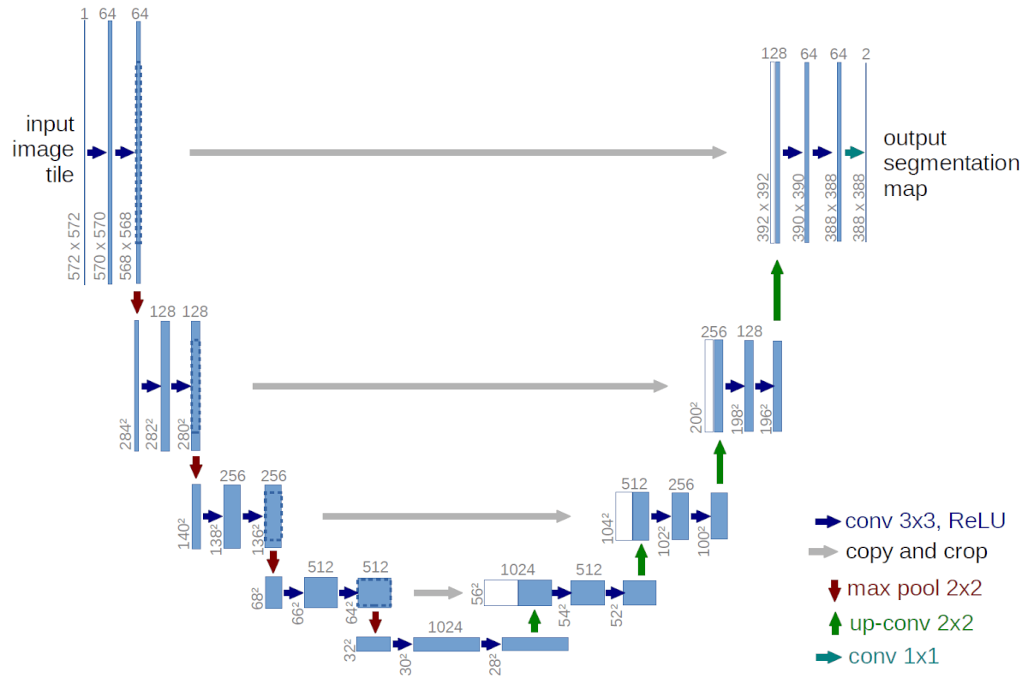
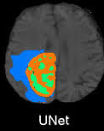
Image Segmentation
Techniques and Models
Notes:
U-Net is considered one of the standard CNN architectures for when we need to not only define the whole image by its class but also to segment areas of an image by class..
The network is also a good choice for this assignment because it is fast, uses a small number of data but still achieves really good results and it has a great track record for having a great performance on various real-life tasks especially biomedical applications.

Slide 11


Performance Evaluation
Notes:
IV. Performance Evaluation
Define IOU and how it is used to evaluate the performance of an image segmentation model
Discuss how IOU relates to Dice and Jaccard's loss
Present the results of the project and discuss their significance

Slide 12

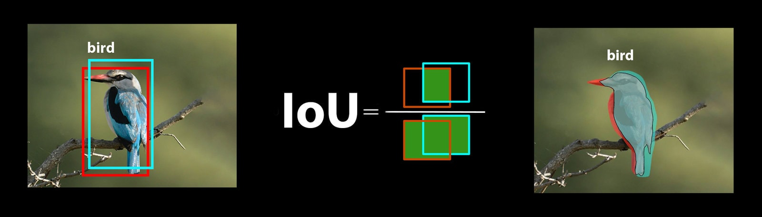

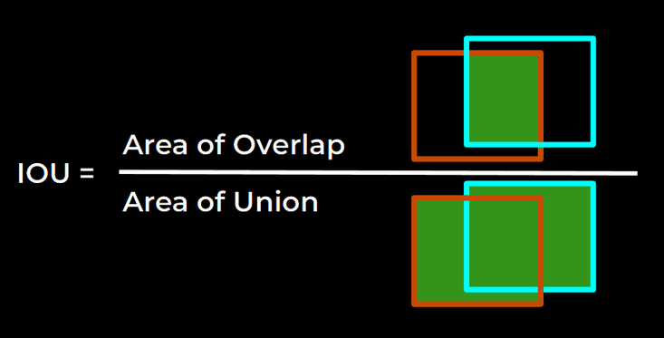
Performance Evaluation
Notes:
Intersection over Union (IoU) and Dice Coefficient are two ways of measuring the accuracy of an Image segmentation model. It is based on the ratio of twice the intersection of the two sets to the sum of the sizes of the two sets, and ranges from 0 to 1, with higher values indicating a greater overlap.
Dice Loss - When comparing the two images to determine the level of similarity, the dice loss is calculated by totaling the number of similar pixels between the two images (or the intersection), multiplying it by 2, and then dividing it by the total number of pixels of the 2 images.
Jaccard coefficient/IoU, is a measure of similarity between two sets, which is used to evaluate the performance of segmentation models by comparing the predicted segmentation mask with the ground truth mask.

Slide 13
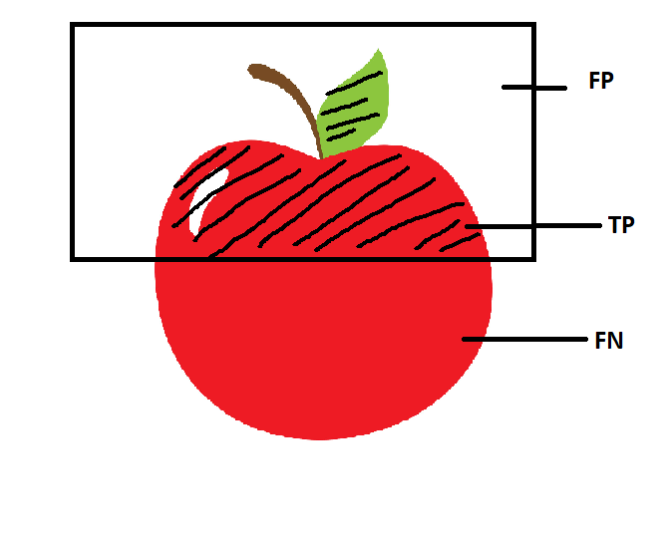
Performance Evaluation
Notes:
Discuss how IOU relates to Dice and Jaccard's loss
Dice coefficient and Jaccard's index both measure how similar two objects are, but they use slightly different formulas. The higher the value of Dice coefficient or Jaccard's index, the more similar the objects are. These measures are important in image segmentation because they help us evaluate how well a computer program has identified objects in an image.
Our performance was evaluated using both of these methods which gives us the ability to gain a comprehensive review of how good our model works.
Jaccard loss is a good choice when the focus is on minimizing false positives. This is because Jaccard loss is sensitive to false positives, and penalizes the model more heavily for including incorrect pixels in the predicted segmentation map. Jaccard loss is often used in medical imaging applications, such as tumor detection, where false positives can have serious consequences.
On the other hand, Dice loss is a good choice when the focus is on minimizing false negatives. This is because Dice loss is more sensitive to small errors in the predicted segmentation map, and penalizes the model more heavily for missing pixels in the ground truth segmentation map. Dice loss is often used in applications where high precision is important, such as object detection in autonomous driving or robotics.
THESE ARE LINKS TO CAPTION OUR IMAGES/ Figures:
https://www.google.com/url?sa=i&url=https%3A%2F%2Flearnopencv.com%2Fintersection-over-union-iou-in-object-detection-and-segmentation%2F&psig=AOvVaw2mhgFvFA9q0q5pfXQdxE2H&ust=1683577604420000&source=images&cd=vfe&ved=0CBAQjRxqFwoTCNDex7qF5P4CFQAAAAAdAAAAABAJ
https://www.google.com/url?sa=i&url=https%3A%2F%2Fwww.jeremyjordan.me%2Fevaluating-image-segmentation-models%2F&psig=AOvVaw2mhgFvFA9q0q5pfXQdxE2H&ust=1683577604420000&source=images&cd=vfe&ved=0CBAQjRxqFwoTCNDex7qF5P4CFQAAAAAdAAAAABAZ
https://www.google.com/url?sa=i&url=https%3A%2F%2Ftowardsdatascience.com%2Fmetrics-to-evaluate-your-semantic-segmentation-model-6bcb99639aa2&psig=AOvVaw08G7y1gMqKvZPoMAQcVdxm&ust=1683577691560000&source=images&cd=vfe&ved=0CBAQjRxqFwoTCNDR9-OF5P4CFQAAAAAdAAAAABAE

Slide 14

Data Augmentation
Notes:
Data Augmentation
Define data augmentation and explain why it is important for image segmentation
Discuss different types of data augmentation methods such as flipping, rotating, scaling, and more
Provide examples of how data augmentation can improve image segmentation results

Slide 15
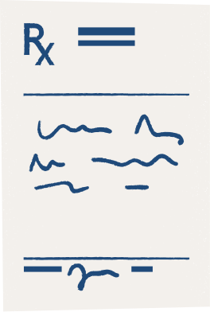
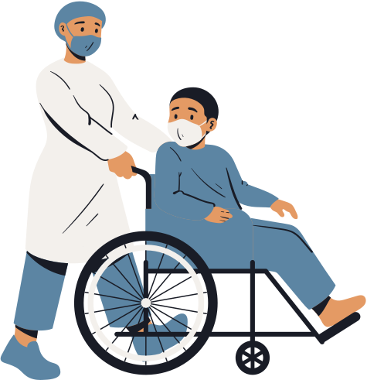




What is Data Augmentation and why is it important for image segmentation?
Data augmentation is a technique used to increase the size of a dataset by creating new data from existing data.
It involves applying a variety of image transformations such as rotations, scaling, and cropping to the original images to create variations of the same image.
Data augmentation is important for image segmentation because it increases the diversity of the dataset and helps to prevent overfitting by providing more examples for the machine learning model to learn from.
Notes:
Data augmentation is a technique that helps to increase the size of the dataset our model is trained on which is extremely important for image segmentation and helps to prevent overfitting.
https://www.google.com/url?sa=i&url=https%3A%2F%2Fpub.towardsai.net%2Fmaximizing-the-impact-of-data-augmentation-effective-techniques-and-best-practices-c4cad9cd16e4&psig=AOvVaw1wYANRBL40TnjQ3AJ2Cuyu&ust=1683577734478000&source=images&cd=vfe&ved=0CBAQjRxqFwoTCMi_sfiF5P4CFQAAAAAdAAAAABAJ

Slide 16
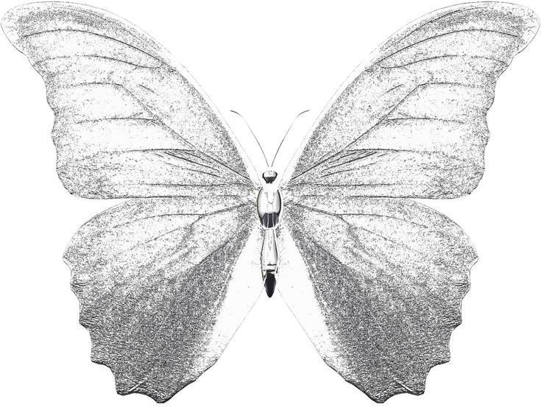
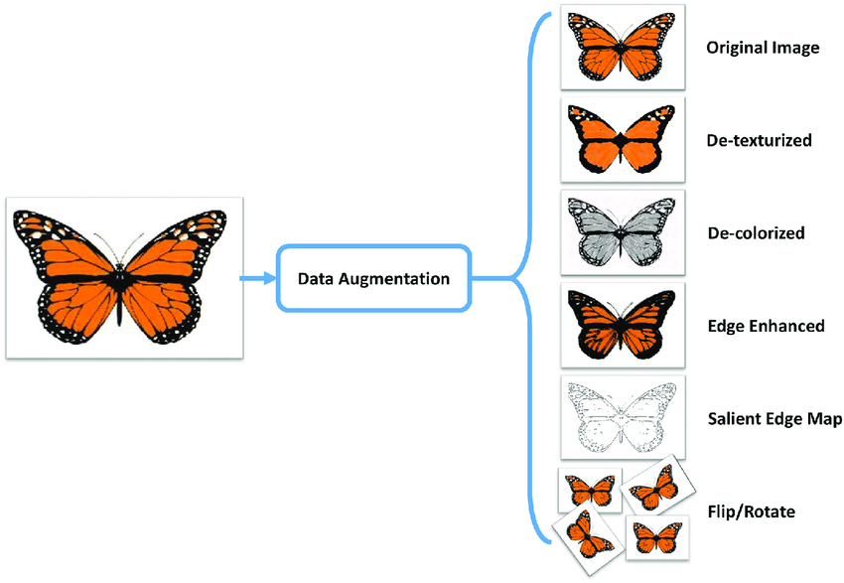
Different types of data augmentation methods
De-texturizing
De-colorizing
Edge Enhancing
Flipping
Rotating
Scaling
Cropping
Notes:
There are quite a few of different types of data augmentation methods such as flipping, rotating, and scaling. In this example we see how this can be done to an image of a butterfly. Data Augmentation helps our model improve it's ability to identify the image we give it by helping it see the same image in many different ways. For example, on the right side we see a part of a butterfly wing and as someone who's seen butterflies in the real world we know what it looks like even without color and only a part of the image showing. Through data augmentation we can sorta train our computer's vision to see like how we do.
https://www.google.com/url?sa=i&url=https%3A%2F%2Fpub.towardsai.net%2Fmaximizing-the-impact-of-data-augmentation-effective-techniques-and-best-practices-c4cad9cd16e4&psig=AOvVaw1wYANRBL40TnjQ3AJ2Cuyu&ust=1683577734478000&source=images&cd=vfe&ved=0CBAQjRxqFwoTCMi_sfiF5P4CFQAAAAAdAAAAABAJ

Slide 17
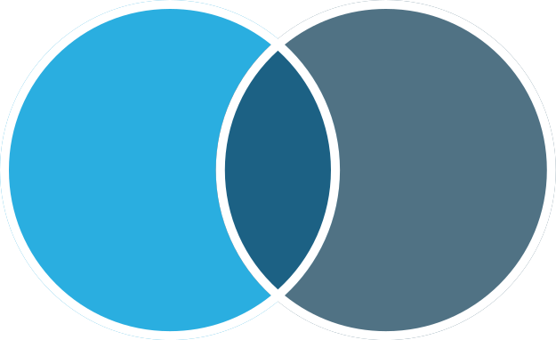
Loss Functions for Image Segmentation
Notes:
VI. Loss Functions for Image Segmentation
Define Dice loss and Jaccard loss
Explain how they are used to measure the similarity between predicted and ground truth segmentation maps
Provide examples of when each loss function may be appropriate

Slide 18


Jaccard Loss
Dice Loss
Short Summary
Short Summary
Jaccard Loss is a measure of dissimilarity between two sets.
It is commonly used as a loss function in machine learning tasks such as image segmentation and object detection, where it measures the similarity between predicted and ground truth sets of pixels or objects.
Dice Loss is a measure of similarity between two sets. It is commonly used as a loss function in image segmentation tasks, where it measures the overlap between predicted and ground truth sets of pixels.
It is similar to Jaccard Loss, but uses the F1 score instead of intersection over union as the similarity measure.
Notes:
From improving our computer's vision we are back to improving the accuracy of
Using both jaccard and dice loss functions improve the robustness of our model by reducing the impact of outliers or noisy data. Combining Jaccard loss and Dice loss can lead to better performance and more reliable results for our image segmentation task.

Slide 19
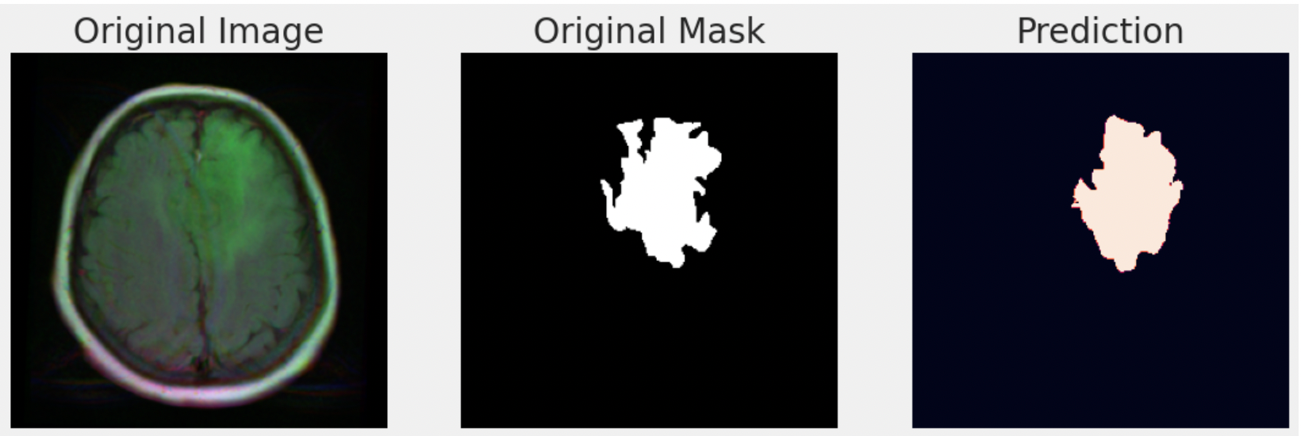
Predicted Mask
Ground Truth
Also called "Original Mask"
a predicted mask is the output of a segmentation model that labels each pixel in an image as belonging to a particular class or object.
The predicted mask is compared to the ground truth mask to evaluate the performance of the model, with the goal of achieving high accuracy and minimizing errors in the segmentation results.
A ground truth mask is a manually annotated segmentation mask that represents the true or desired segmentation of an image.
Each pixel in the mask is labeled with a corresponding class or object, and it serves as a standard of comparison for evaluating the accuracy and performance of machine learning algorithms used for image segmentation tasks.
Notes:
Jaccard and Dice are two ways to check if a computer program that identifies things in pictures is doing a good job. For example, if we want to find the cancerous parts in a brain scan, we need to make sure the program is doing it correctly.
To check this, we compare the program's result (which is called the predicted segmentation map) to the real result done by a doctor (which is called the ground truth segmentation map).
Provide examples of when each loss function may be appropriate....!!!!!
put an EMPHASIS ON original masks (ground truth) vs predicted mask
https://www.google.com/url?sa=i&url=https%3A%2F%2Fencord.com%2Fblog%2Fimage-segmentation-for-computer-vision-best-practice-guide%2F&psig=AOvVaw1Mmw2IKCQ_SMYDrG-VdGUX&ust=1683577790294000&source=images&cd=vfe&ved=0CBAQjRxqFwoTCJDj9pKG5P4CFQAAAAAdAAAAABAE

Slide 20

Results

Slide 21
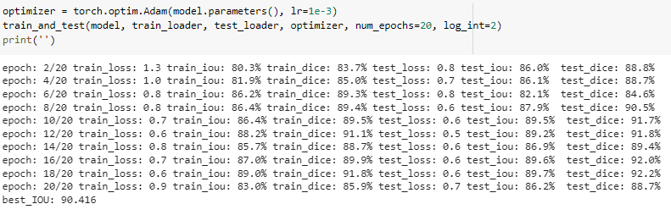

Results
Notes:
We used 20 epochs with results printed every 2 iterations, and as you can see out best IOU was 90.416%, meaning the predicted image fit the mask 90% - like a 90% match between the two. This means that 90% of the pixels in the two images are the same, giving us a 90% pixel accuracy

Slide 22
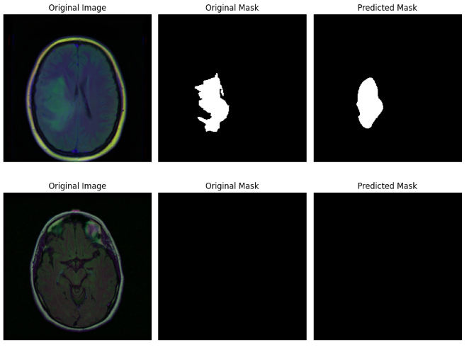
Results
Row 1
Row 2
Notes:
1st row - Here's the MRI, then the mask displaying the brain tumor, and here's what the model predicted to be as the brain tumor, as you can see they're relatively close, but not perfect.
2nd row - In this MRI there is no brain tumor, as such there's a negative mask as there's nothing to isolate from the image, and the model is able to correctly predict that there is no brain tumor present.

Slide 23
Conclusion
Notes:
VII. Conclusion
The performance of the segmentation model when it's using IOU, Dice, and Jaccard coefficients ********
Using image segmentation for identifying LGG tumors could possibly revolutionize the healthcare industry and the medical image analysis process. The potential for further research in this area is equally impactful.

Slide 24
Conclusion
Performance of the segmentation model when using:
IOU
~90%
Dice coefficients
~92%
Notes:
VII. Conclusion
The performance of the segmentation model when it's using IOU, Dice, and Jaccard coefficients ********
Using image segmentation for identifying LGG tumors could possibly revolutionize the healthcare industry and the medical image analysis process. The potential for further research in this area is equally impactful.

Slide 25
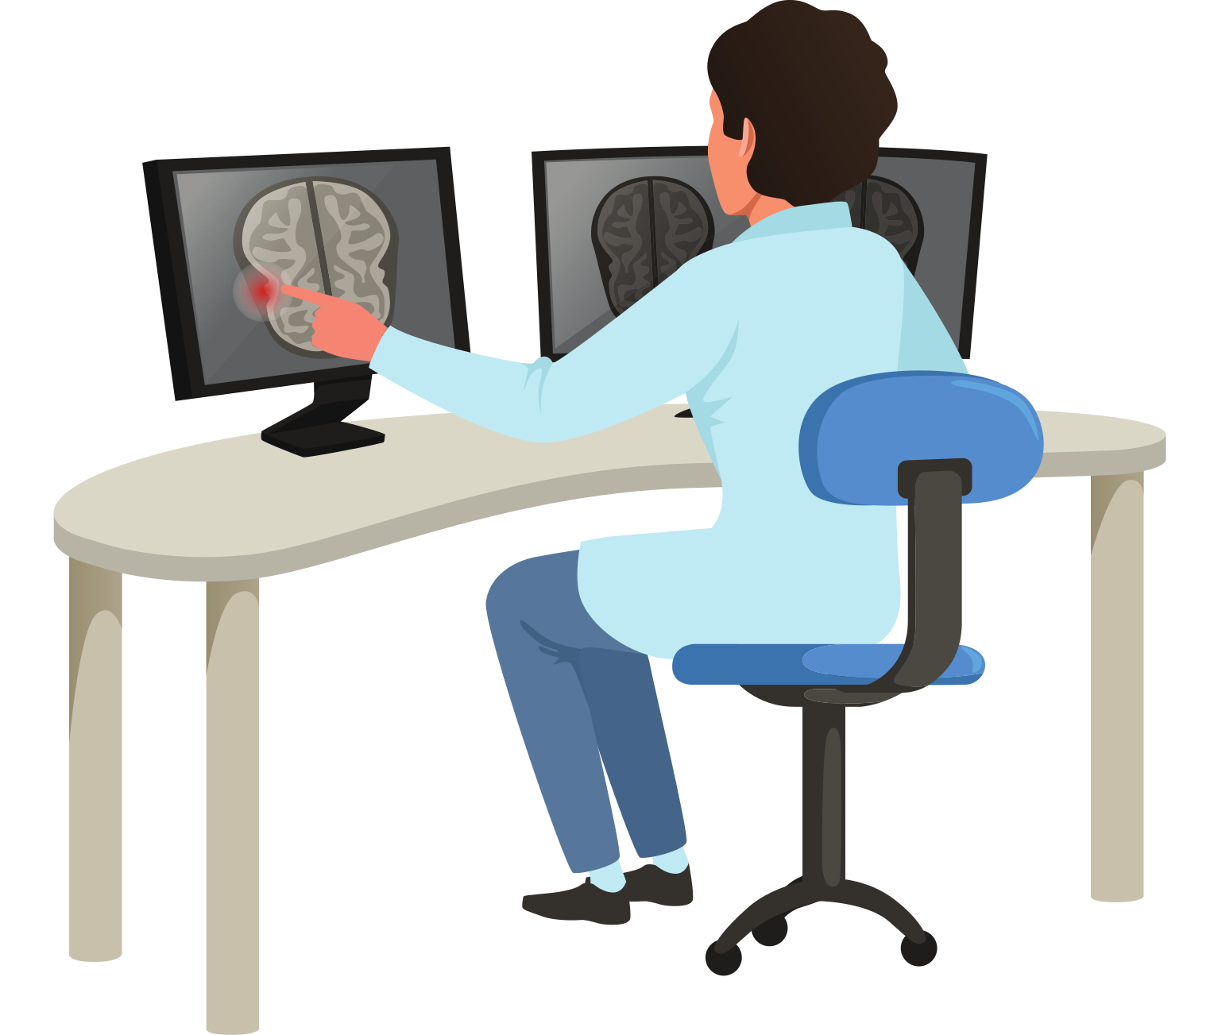
Supporting Resources
Ronneberger, Olaf, Philipp Fischer, and Thomas Brox. "U-Net: Convolutional Networks for Biomedical Image Segmentation." International Conference on Medical Image Computing and Computer-Assisted Intervention. Springer, Cham, 2015.
Milletari, Fausto, Nassir Navab, and Seyed-Ahmad Ahmadi. "V-Net: Fully Convolutional Neural Networks for Volumetric Medical Image Segmentation." 3D Vision (3DV), 2016 Fourth International Conference on. IEEE, 2016.
Isensee, Fabian, et al. "Automated Design of Deep Learning Methods for Biomedical Image Segmentation." arXiv preprint arXiv:1904.08128 (2019).
Christ, Patrick F., et al. "Automatic Liver and Lesion Segmentation in CT Using Cascaded Fully Convolutional Neural Networks and 3D Conditional Random Fields." Medical Image Analysis 39 (2017): 231-244.
Cireşan, Dan C., et al. "Deep neural networks segment neuronal membranes in electron microscopy images." Advances in neural information processing systems. 2012.

Slide 26

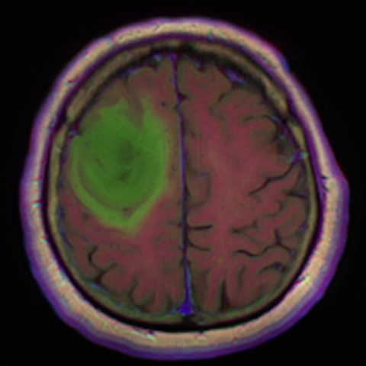
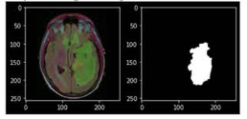
Questions or comments?
Please Ask Now
Special Thank You To Our Advisor:
Dr. Erdi Kara, Spelman College

